Slide 1
Logical Design
Dharmishta Ghosh
Portfolio Website
COMP296-801RL
Spring 2016

Slide 2
Introduction
Flow Chart
User Interface
Database Table Structures

Slide 4
Sitemap
Home Page
Login Page
Contact Page
About Page
Gallery Page
Projects Page
Administration Page

Slide 5
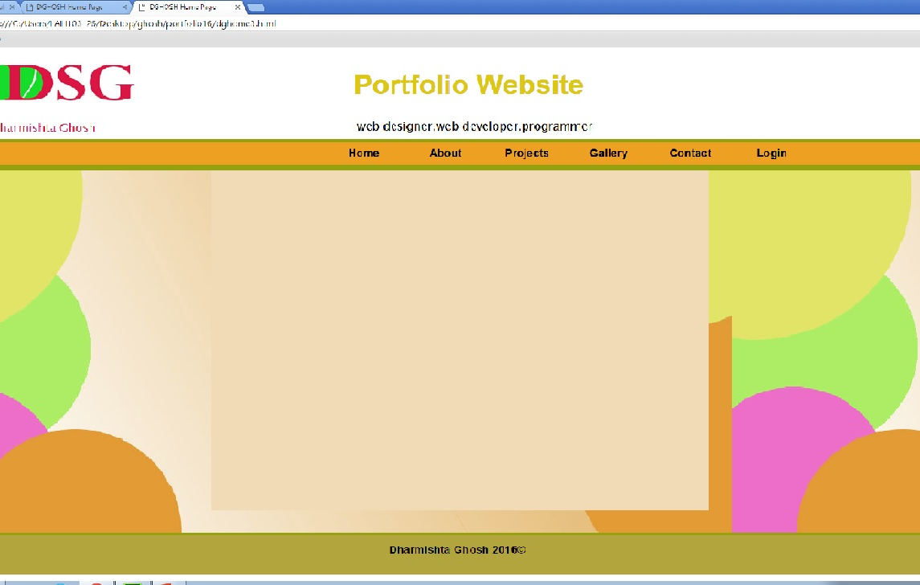
Home Page
This will be the home page for the Portfolio Website. It contains the logo, title, and Navigation Menu in the header, main content, and the footer.
Through the Navigation Menu, you can go to any other page shown in the menu by clicking on it.

Slide 6
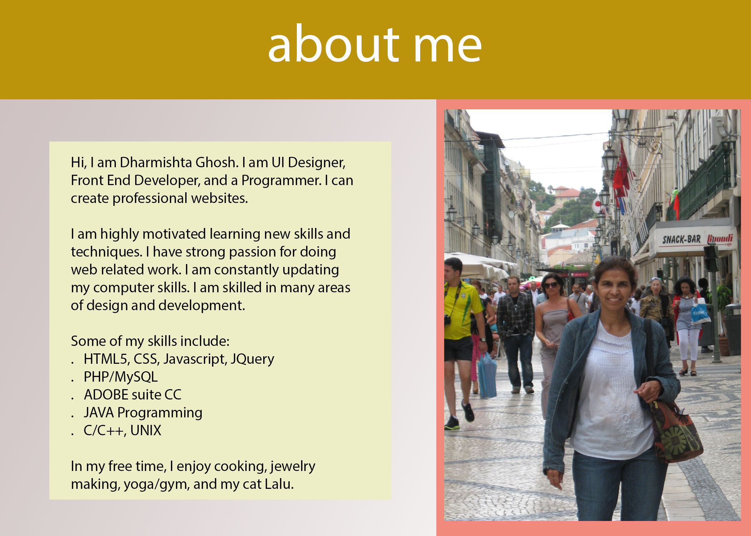
About Page
About page is displayed when you click About from the menu on the Home Page.
It talks about Dharmishta Ghosh and the purpose of the Portfolio website.

Slide 7
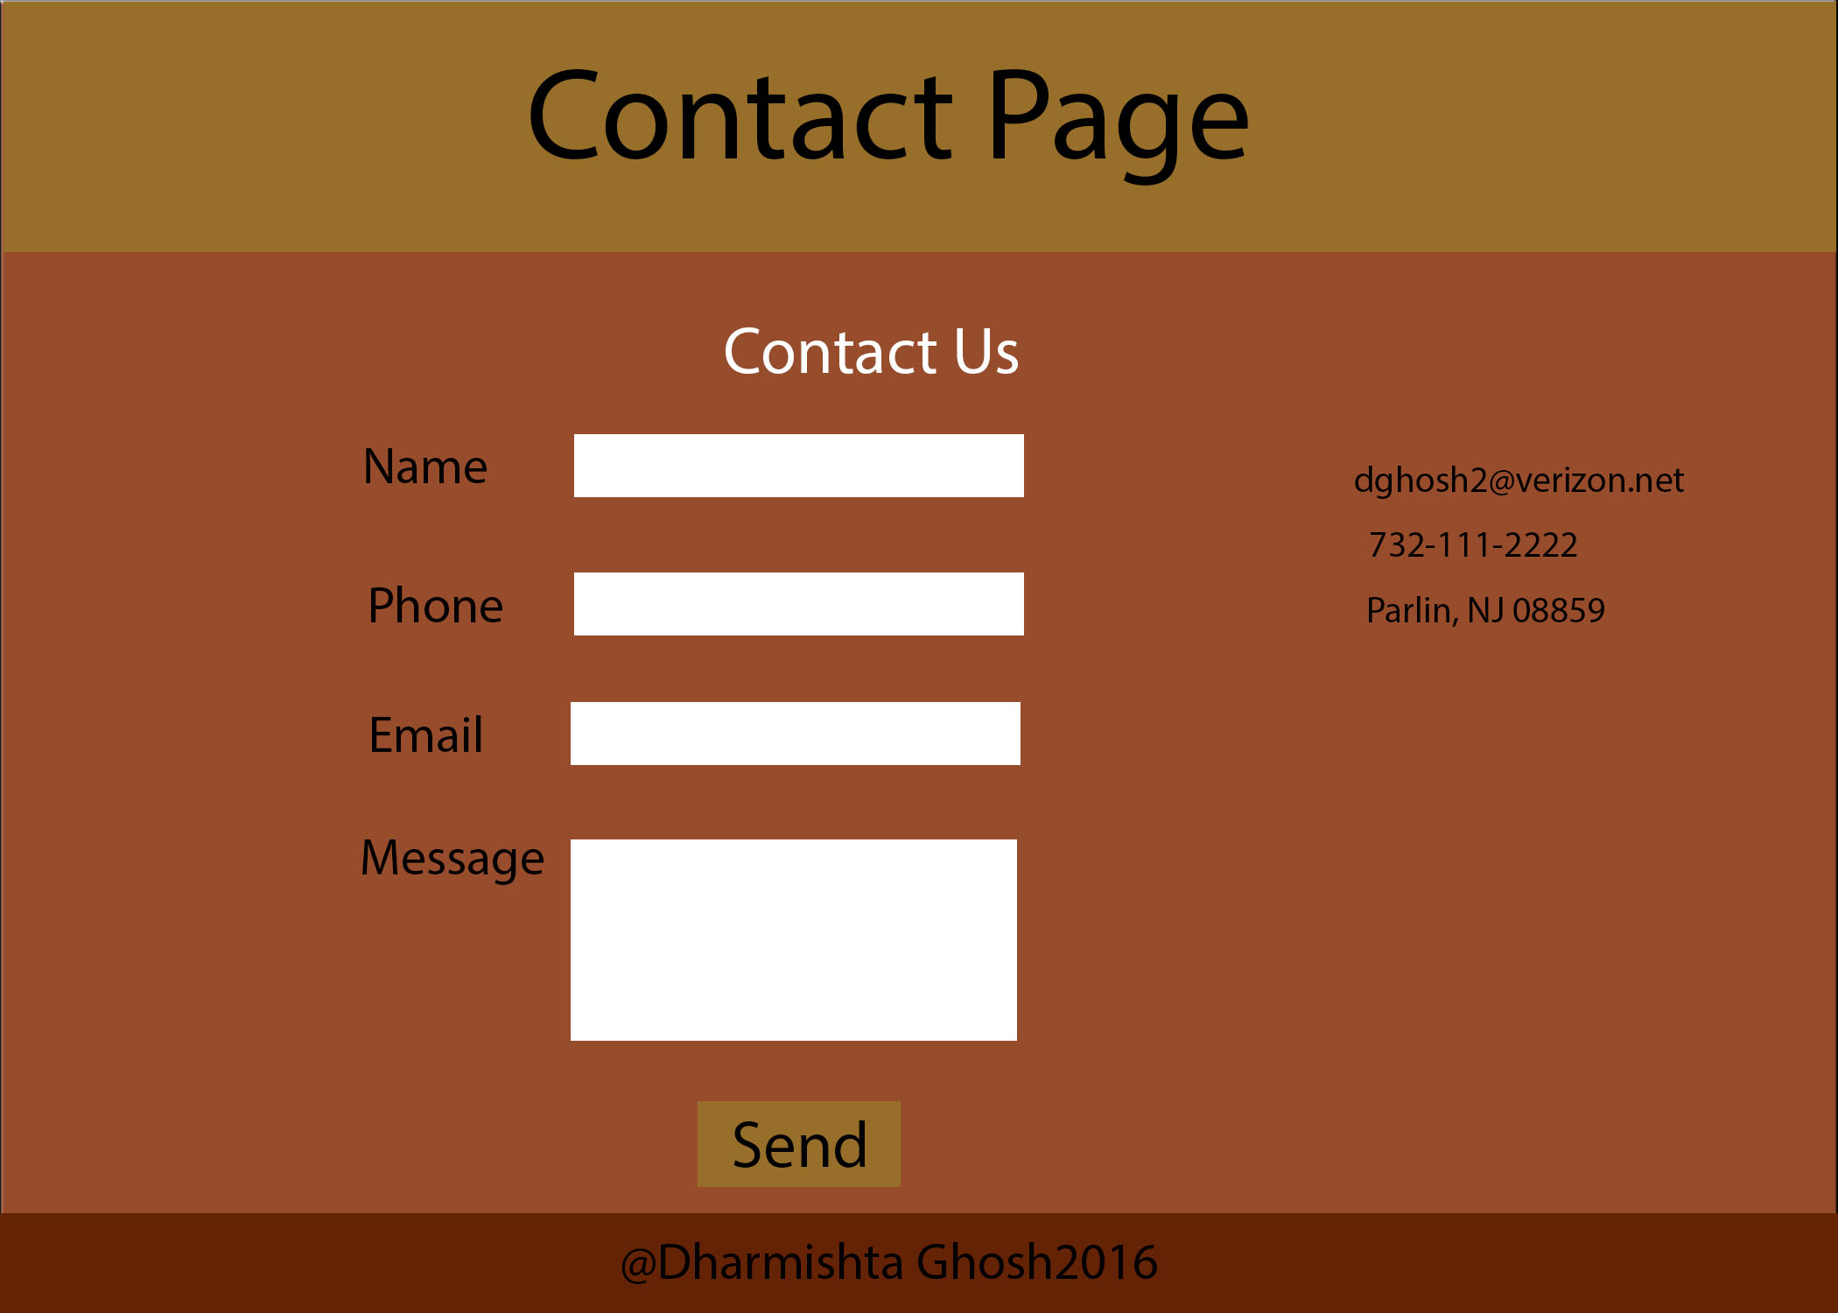
Contact Page
When the contact is selected from the Home Page menu, the contact page is displayed.
It displays the email, phone, and address of Dharmishta Ghosh. It also asks the guest to enter their contact info, such as Name, Phone, Email, and the message so that she can contact that person and discuss the detail of the business.

Slide 8
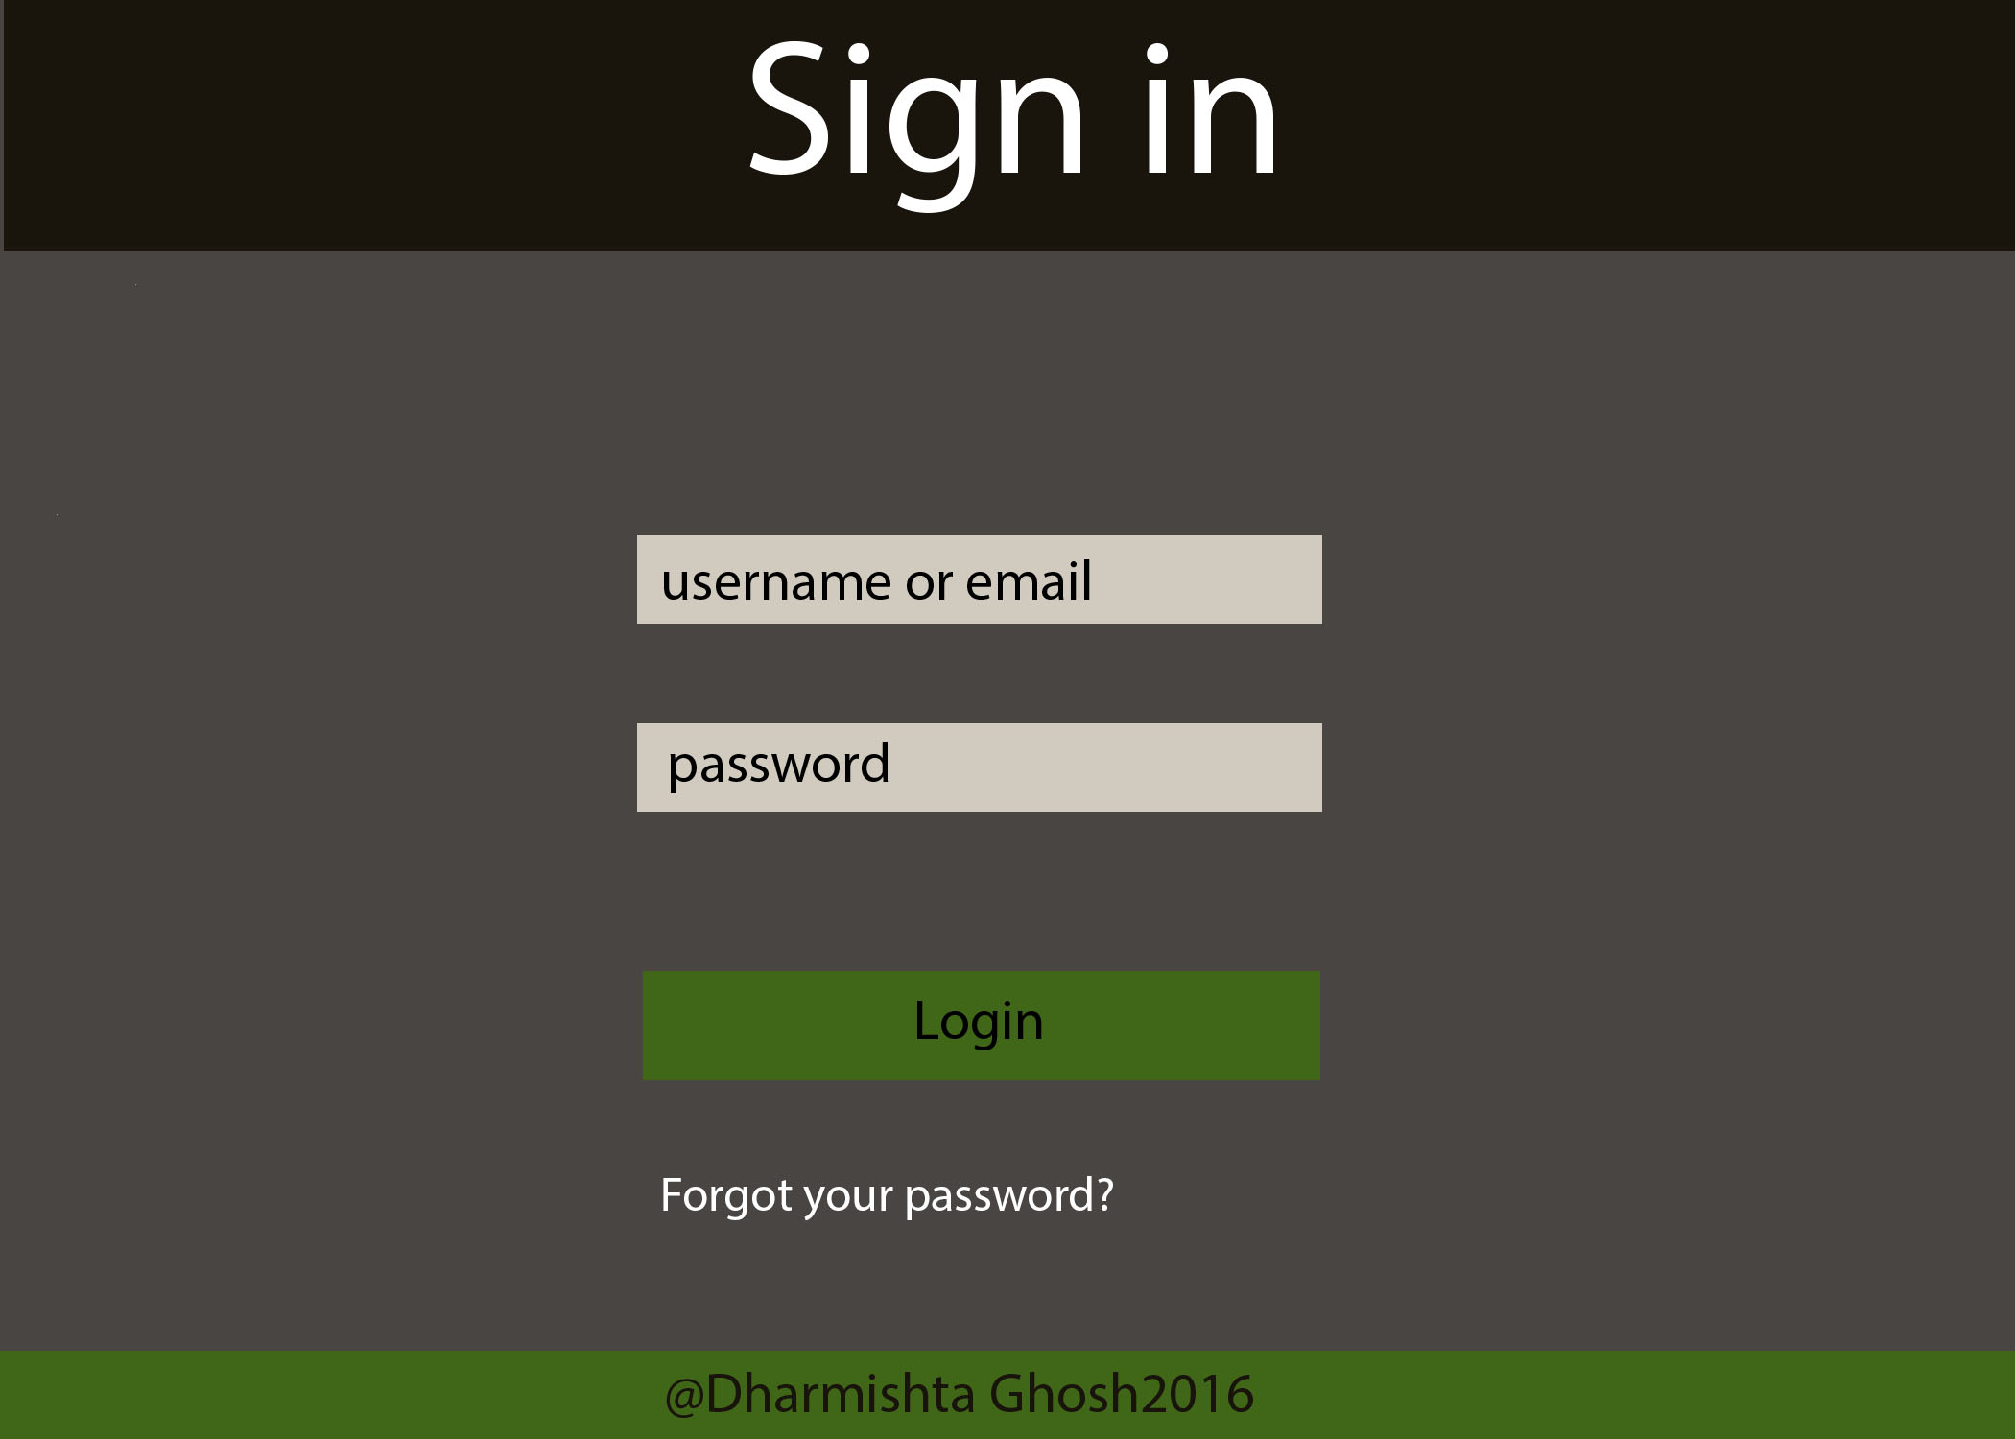
Login Page
When the Login is selected from the Home Page menu, the login page is displayed.
It asks the user to enter the Username, and Password. Once the user is successfully logged in, then the user can see the Project files. This is only for the users who are authorized to do that.

Slide 9
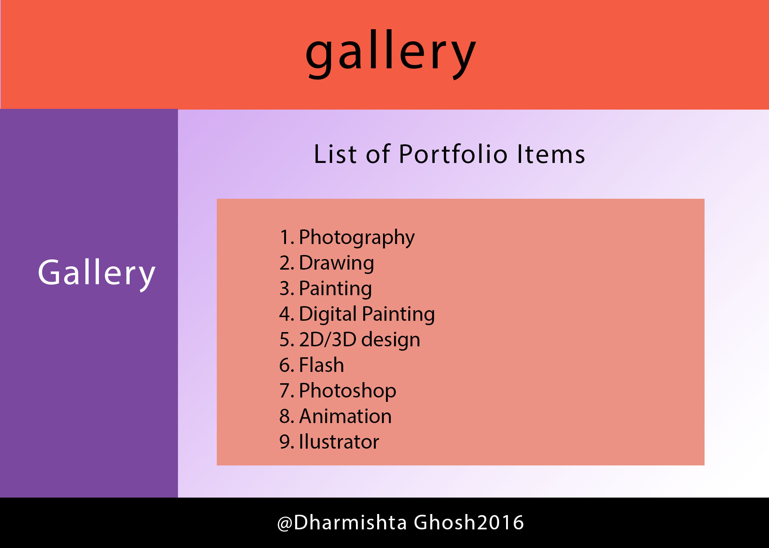
Gallery Page
When the user selects the Gallery from the Home page menu, the gallery page is displayed.
Gallery shows the list of Gallery items. The user can select any one of them, and it will display the images of the Portfolio items for that category. For example, if the user selects Photography from the Gallery, then the Photography page will open and it will display photos taken by D. Ghosh.

Slide 10
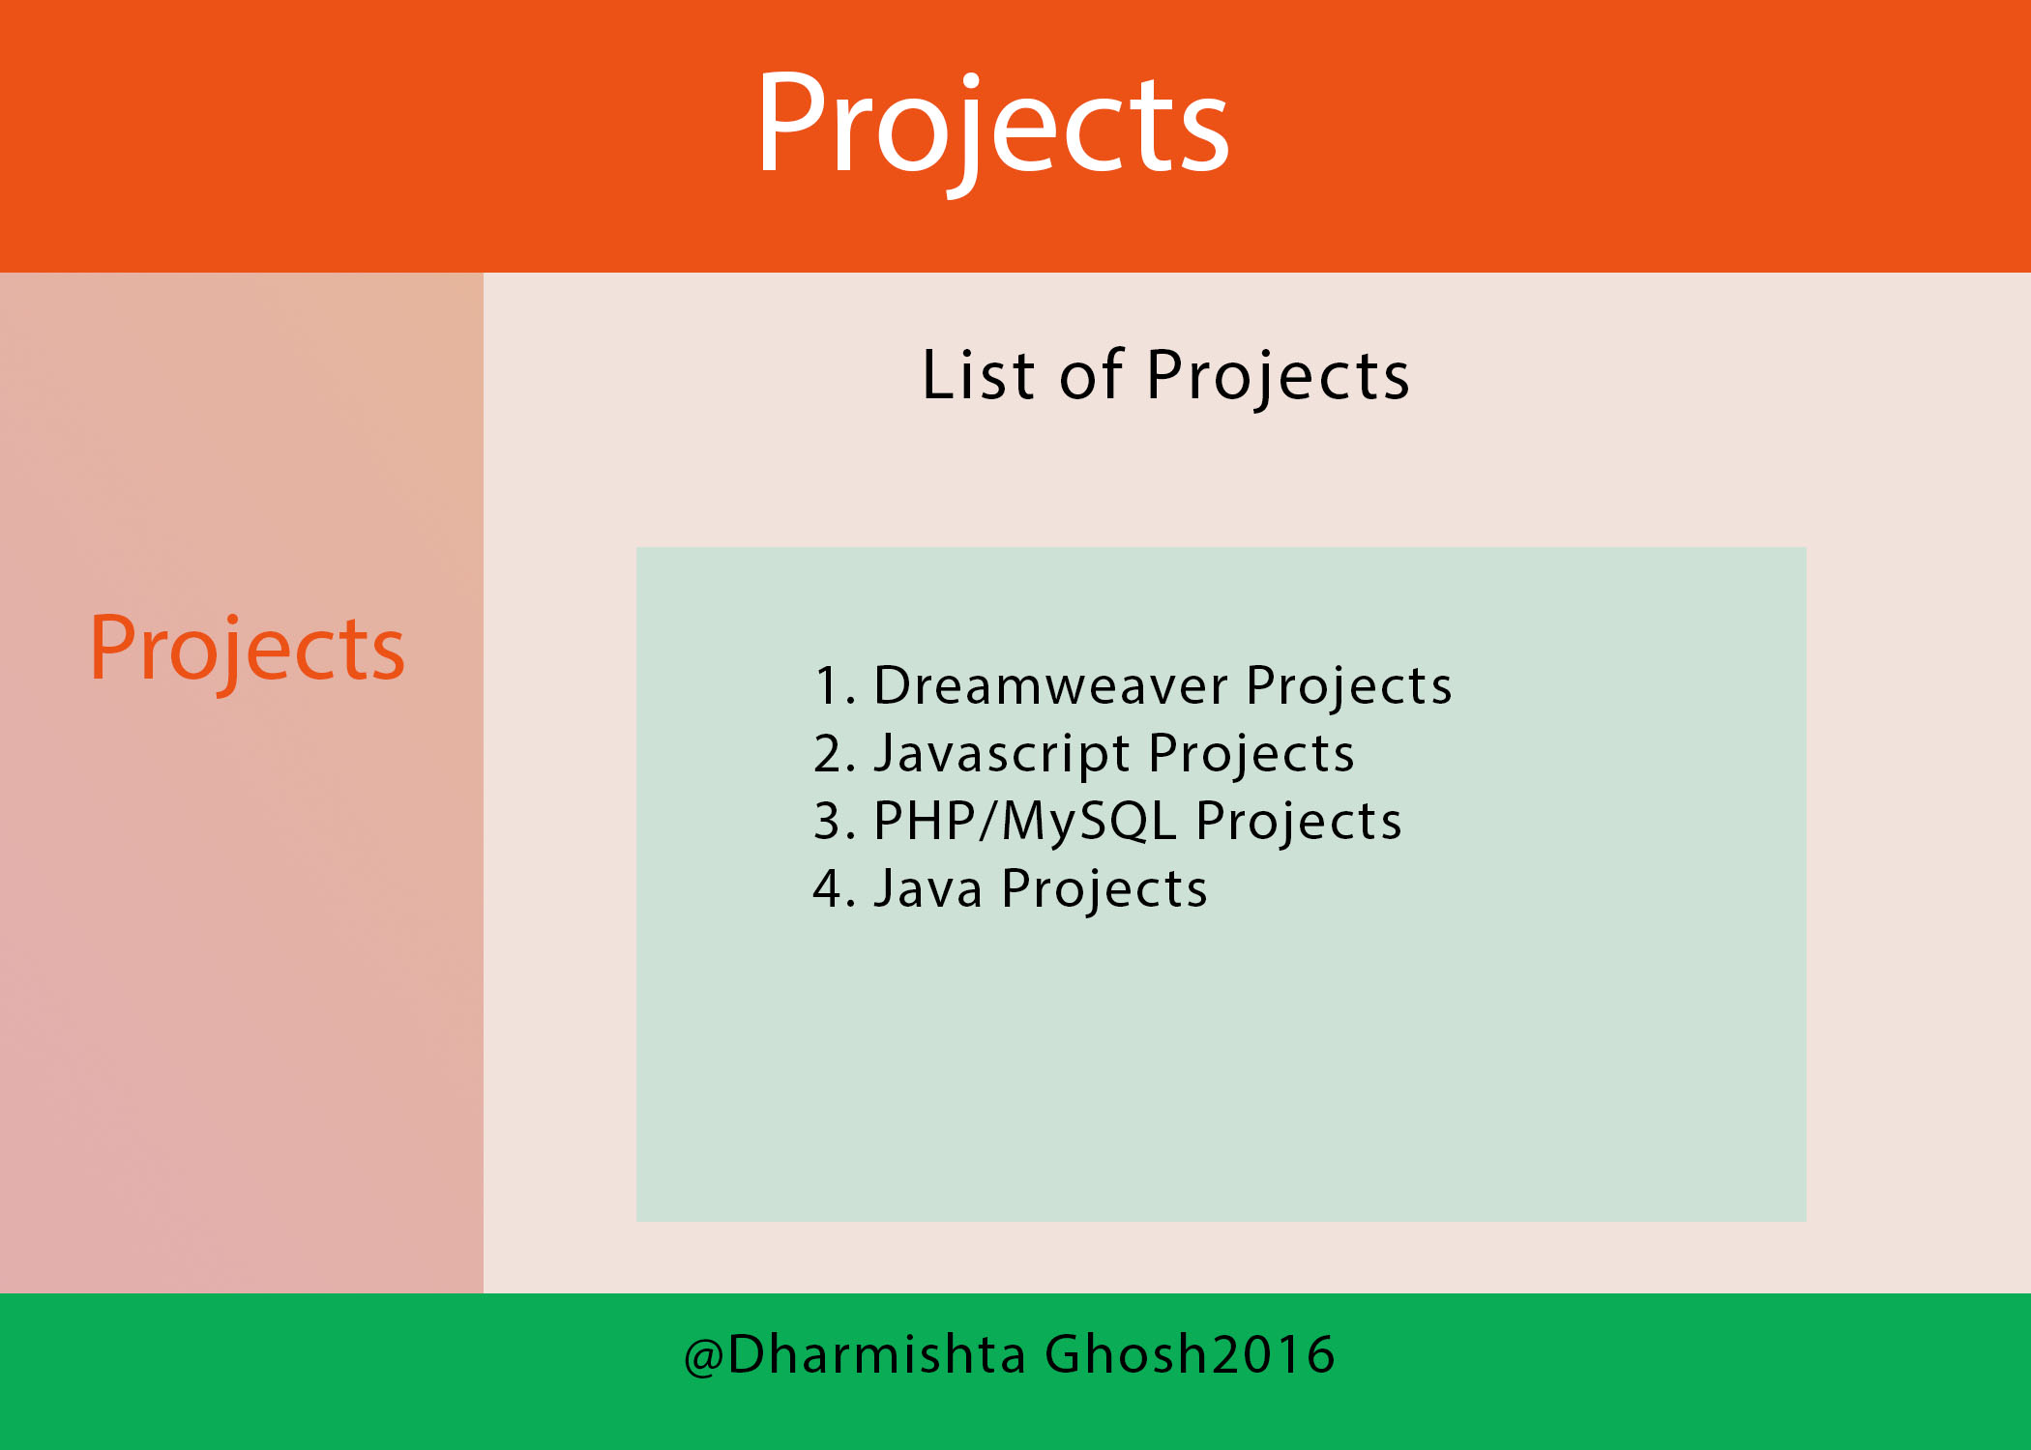
Projects Page
If the user selects Projects from the Home Page Menu, the Projects page is displayed.
It will display the List of Projects. If the user selects one of the Projects Category by clicking the id, for example Dreamweaver, then the Dreamweaver Projects page is displayed. It displays all Dreamweaver Projects. If the user clicks any of them then it will open up that link.

Slide 11
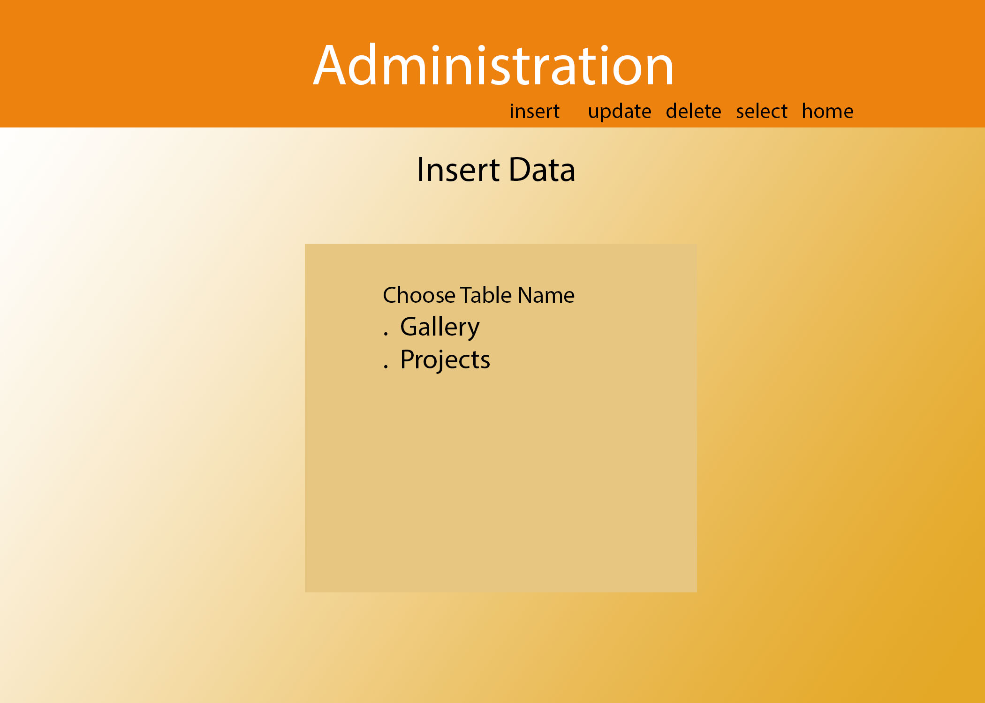
Administrative Page
This page is accessible by the administrator of the webpage. It will be hidden from the user.
The only way to view this page is to login with the admin account.
It will allow to insert, delete, and upgrade the database items such as gallery and projects.

Slide 12
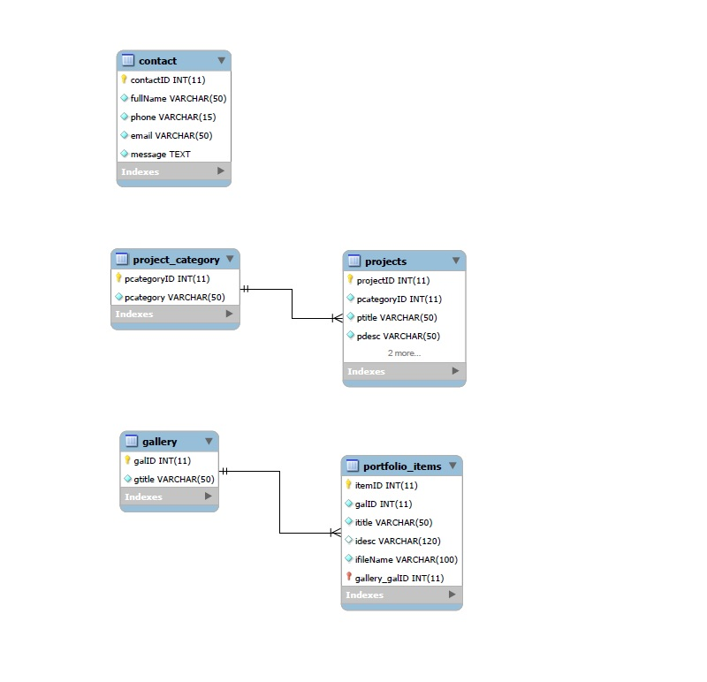
ER Diagram
This is the ER Diagram for the Portfolio Database. It shows the layout of the tables and their relationship.

Slide 13
Portfolio Database Script file

